Slide 1
Chapter 3
The Greedy Method
3 -<number>

Slide 2
The greedy method
Suppose that a problem can be solved by a sequence of decisions. The greedy method has that each decision is locally optimal. These locally optimal solutions will finally add up to a globally optimal solution.
Only a few optimization problems can be solved by the greedy method.
3 -<number>

Slide 3
A Simple Example
Problem: Pick k numbers out of n numbers such that the sum of these k numbers is the largest.
Algorithm:
    FOR i = 1 to k
    Pick out the largest number and
    delete this number from the input.
    ENDFOR
3 -<number>

Slide 4
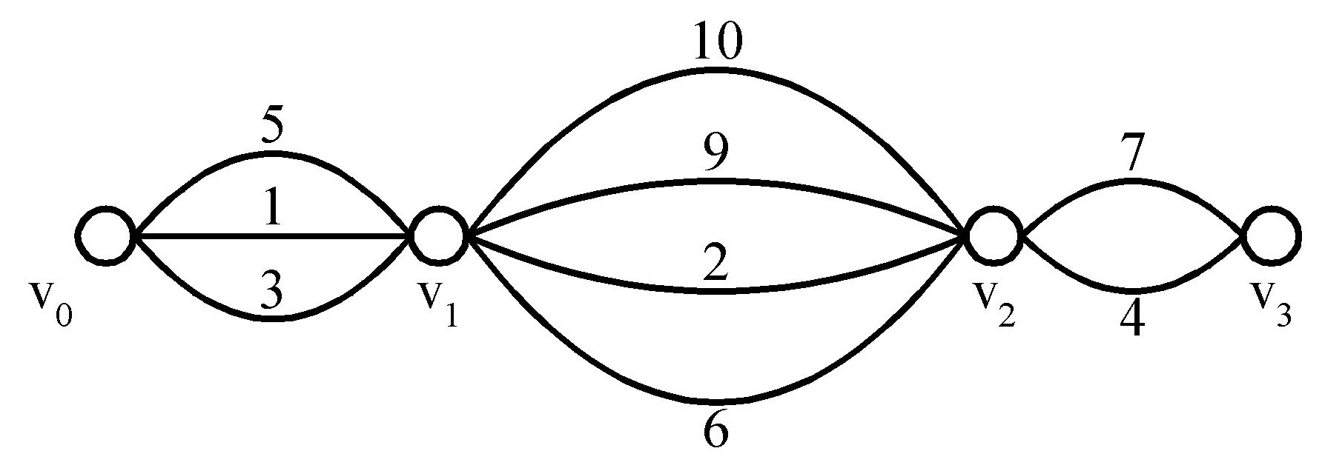
Shortest Paths on a Special Graph
Problem: Find a shortest path from v₀ to v₃.
The greedy method can solve this problem.
The shortest path: 1 + 2 + 4 = 7.
3 -<number>

Slide 5
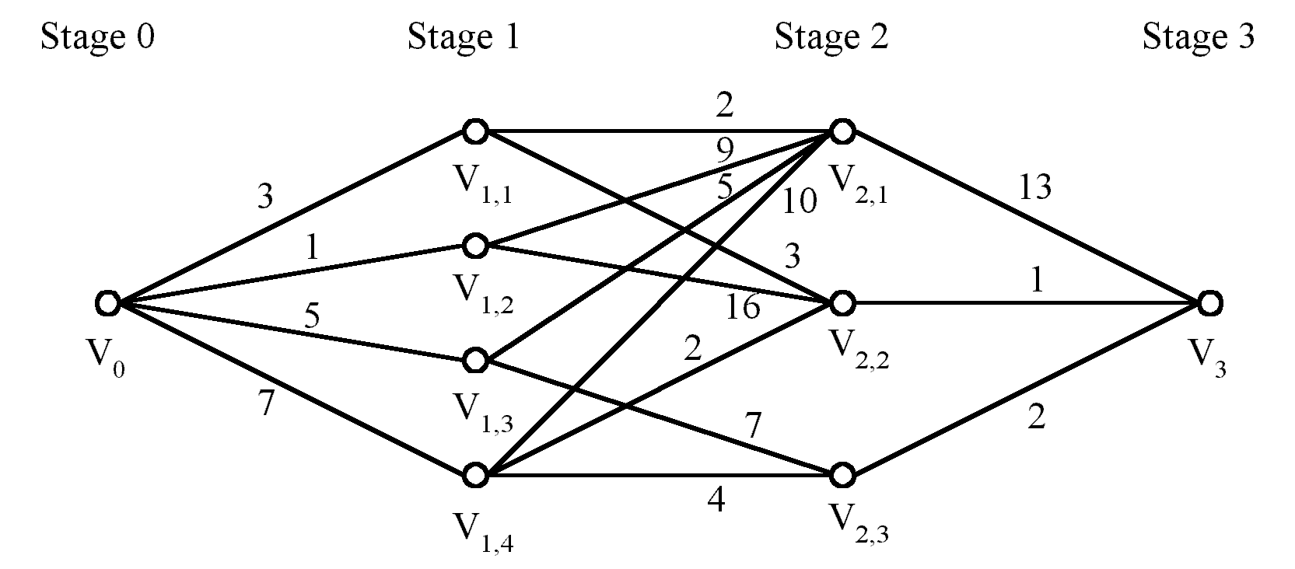
Shortest Paths on a Multi-stage Graph
Problem: Find a shortest path from v₀ to v₃ in a multi-stage graph.
Greedy method: v₀v_{1,2}v_{2,1}v₃ = 23
Optimal: v₀v_{1,1}v_{2,2}v₃ = 7
The greedy method does not work.
3 -<number>

Slide 6
This problem can be solved by the dynamic programming method which will be introduced later.
3 -<number>

Slide 7
Minimum Spanning Trees (MST)
It may be defined on Euclidean space points or on a graph.
G = (V, E): weighted connected undirected graph
Spanning tree: T = (V, S), S ⊆ E.
Minimum spanning tree(MST): a spanning tree with the smallest total weight.
3 -<number>

Slide 8
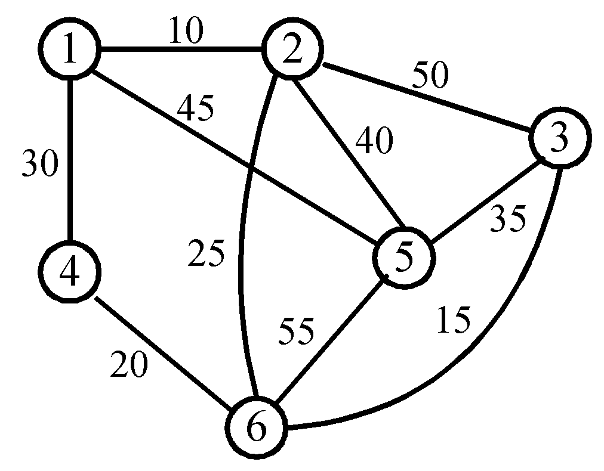
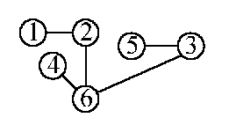
An Example of MST
A graph and one of its minimum spanning trees.
3 -<number>

Slide 9
Kruskal’s Algorithm for Finding MST
Input : A weighted, connected and undirected graph
G = (V, E ).
Output : A minimal spanning tree for G.
T : = φ
While T contains less than n - 1 edges do
Begin
Choose an edge (v, w) from E of the smallest weight
Delete (v, w) from E
If (the adding of (v, w) to T does not create a cycle in T) then
Add (v, w) to T
Else
Discard (v, w)
End
3 -<number>

Slide 10
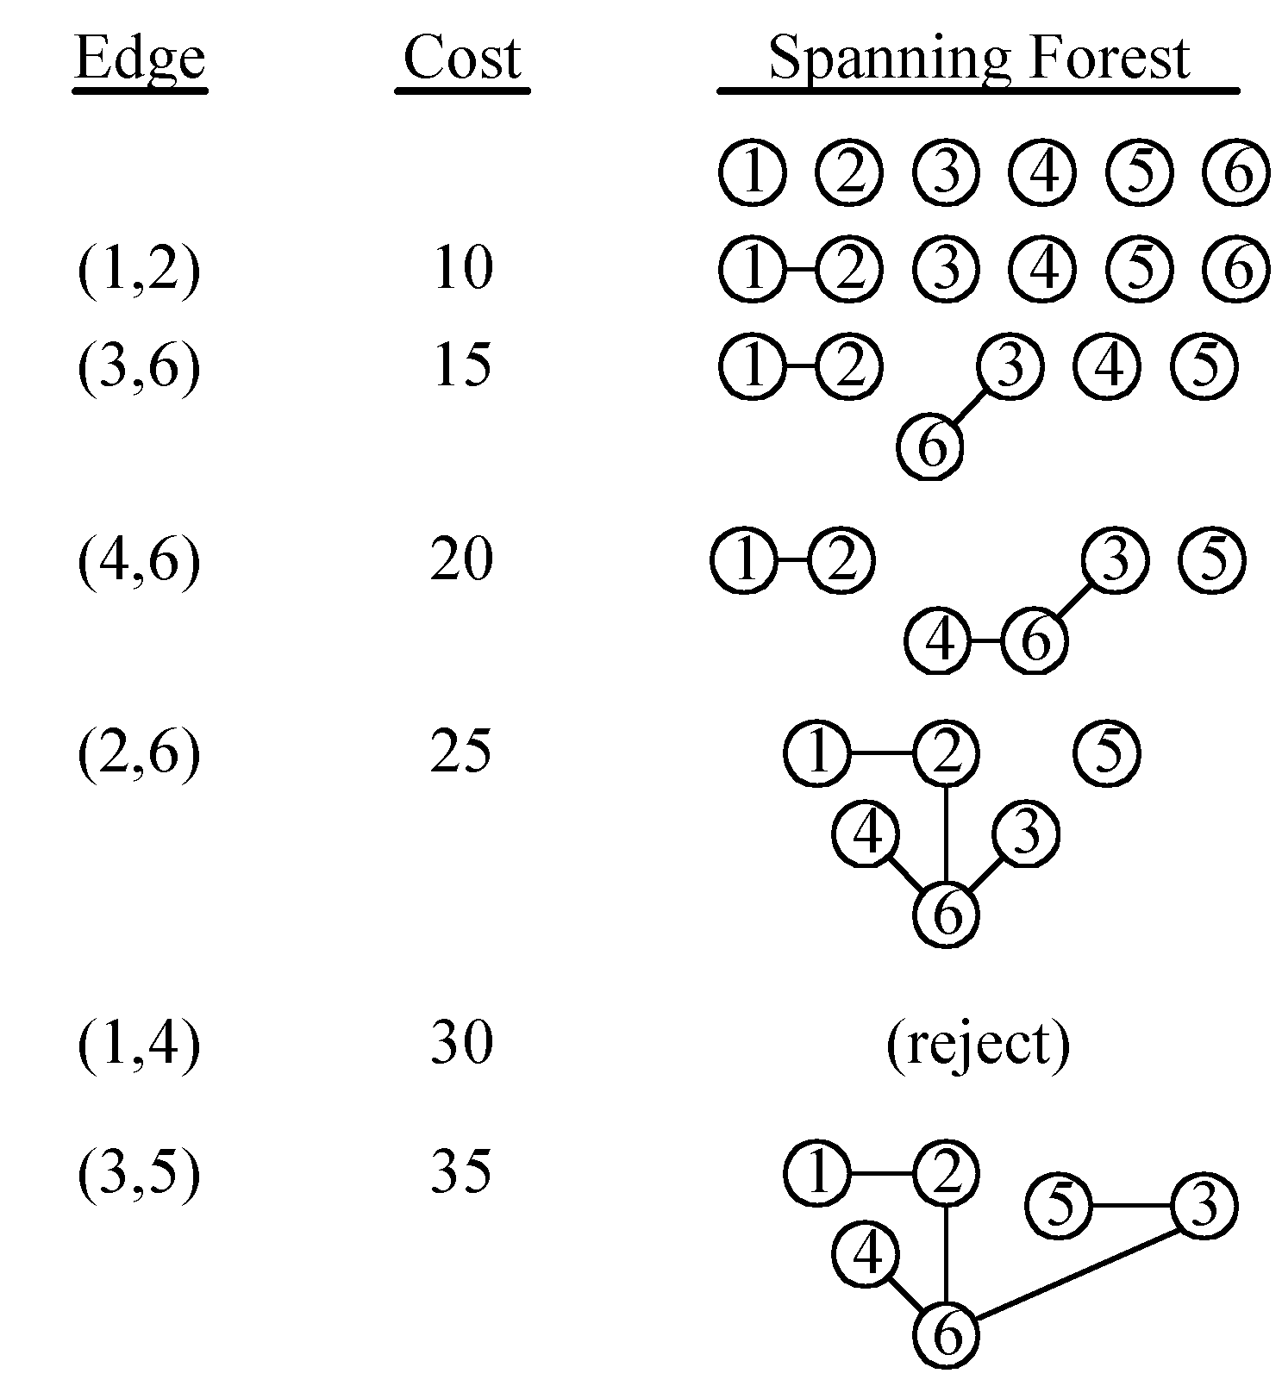
An example of Kruskal’s algorithm
3 -<number>

Slide 11
The Details for Constructing an MST
How do we check if a cycle is formed when a new edge is added?
  By the SET and UNION algorithm introduced later.
A tree in the forest is used to represent a SET.
If (u, v) ∈ E and u, v are in the same set, then the addition of (u, v) will form a cycle.
If (u, v) ∈ E and u∈S₁ , v∈S₂ , then perform UNION of S₁ and S₂ .
3 -<number>

Slide 12
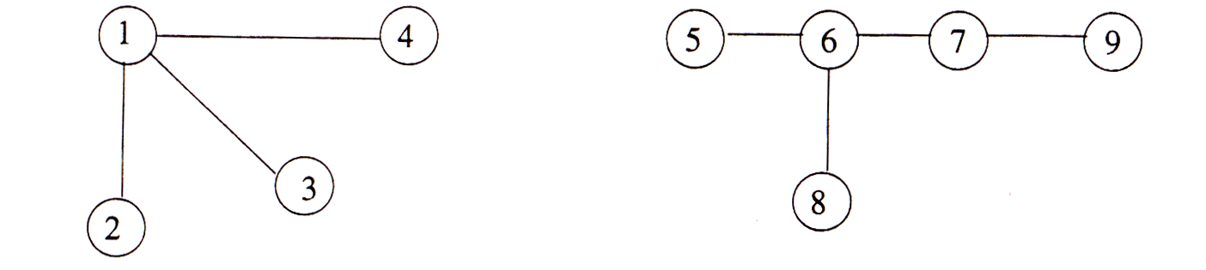
A spanning forest
If (3,4) is added, since 3 and 4 belong to the same set,
a cycle will be formed.
If (4,5) is added, since 4 and 5 belong to different sets,
a new forest (1,2,3,4,5,6,7,8,9) is created.
Thus we are always performing the union of two sets.
3 -<number>

Slide 13
Time Complexity of Kruskal’s Algorithm
Time complexity: O(n²logn)
Sorting:
O(|E|log|E|) = O(n²logn), where n = |V|.
Union two sets:
O(n²)
Finding an edge in a set:
O(|E|) = O(n²)
3 -<number>

Slide 14
Prim’s Algorithm for Finding an MST
Step 1: x ∈ V, Let A = {x}, B = V - {x}.
Step 2: Select (u, v) ∈ E, u ∈ A, v ∈ B such that (u, v) has the smallest weight between A and B.
Step 3: Put (u, v) into the tree. A = A ∪ {v}, B = B - {v}
Step 4: If B = ∅, stop; otherwise, go to Step 2.
Time complexity : O(n²), n = |V|.
3 -<number>

Slide 15
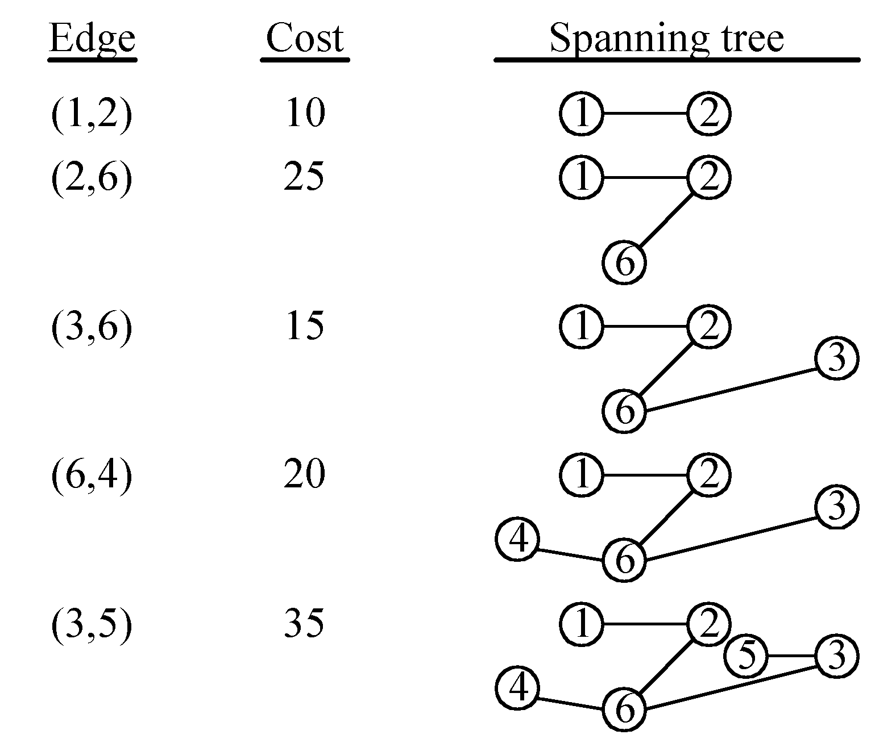
An Example for Prim’s Algorithm
3 -<number>

Slide 16
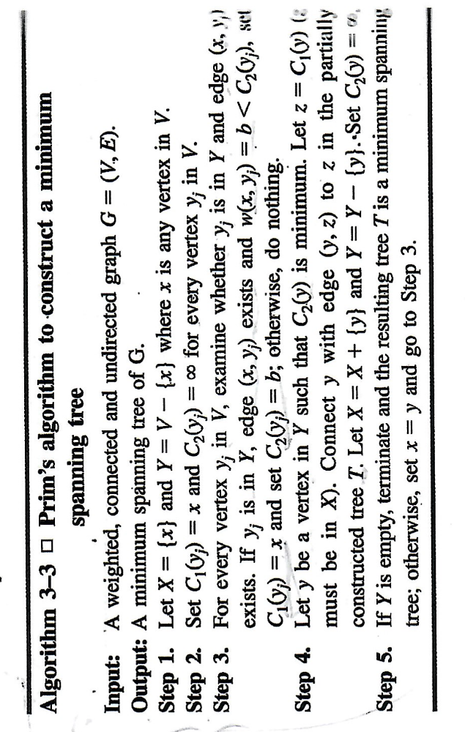
Prim’s Algorithm
3 -<number>

Slide 17
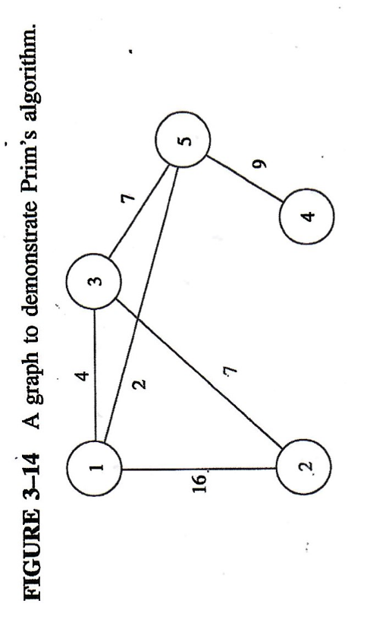
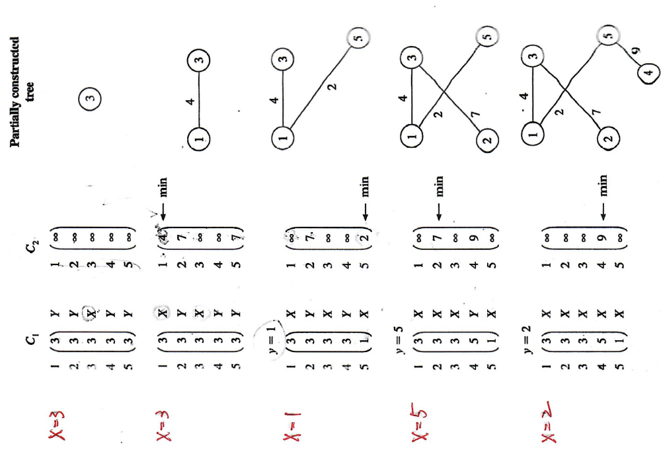
3 -<number>

Slide 18
Given two sorted lists L₁ and L₂, L₁ = (a₁ , a₂ , ... , a_{n1}) and L₂ = (b₁ , b₂ , ... , b_{n2}), we can merge L₁ and L₂ into a sorted list by using the following algorithm.
3 -<number>

Slide 19
Linear Merge Algorithm
Input: Two sorted lists, L₁ = ( a₁ , a₂ , ... , a_{n1}) and L₂ = (b₁ , b₂ , ... , b_{n2}).
Output: A sorted list consisting of elements in L₁ and L₂ .
Begin
i : = 1
j : = 1
do
compare a_{i} and b_{j}
if a_{i} > b_{j} then output b_{j} and j : = j + 1
else output a_{i} and i : = i + 1
while (i ≤ n1 and j ≤ n2)
if i > n1 then output b_{j} , b_{j+1} , ... , b_{n2} ,
else output a_{i} , a_{i+1} , ... , a_{n1} .
End.
3 -<number>

Slide 20
If more than two sorted lists are to be merged, we can still apply the linear merge algorithm, which merges two sorted lists, repeatedly. These merging processes are called 2-way merge because each merging step only merges two sorted lists.
3 -<number>

Slide 21
A Greedy Algorithm to Generate an Optimal 2-Way Merge Tree
Input: m sorted lists, L_{i}, i = 1, 2, ... , m, each L_{i} consisting of n_{i} elements.
Output: An optimal 2-way merge tree.
Step 1. Generate m trees, where each tree has exactly one node (external node) with weight n_{i} .
Step 2. Choose two trees T₁ and T₂ with minimal weights.
Step 3. Create a new tree T whose root has T₁ and T₂ as its subtrees and weight are equal to the sum of weights of T₁ and T₂ .
Step 4. Replace T₁ and T₂ by T.
Step 5. If there is only one tree left, stop and return; otherwise, go to Step 2.
3 -<number>

Slide 22
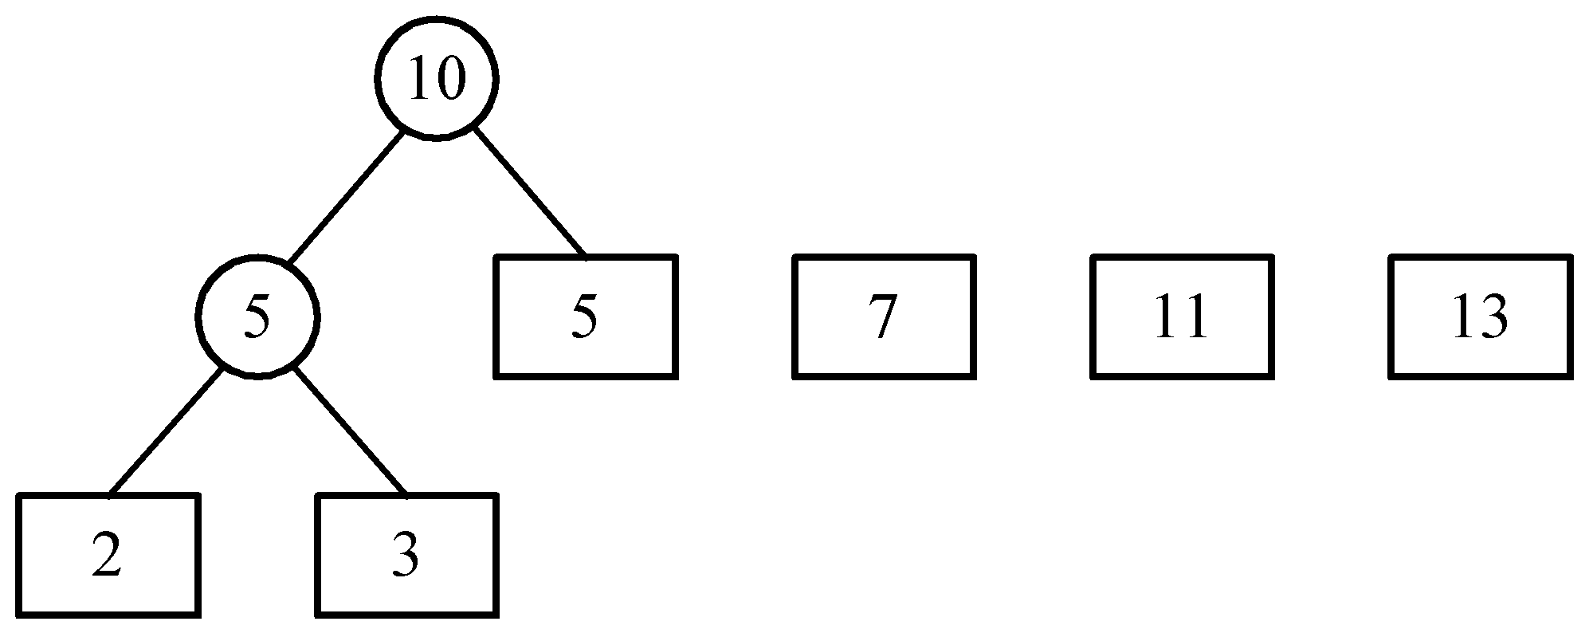
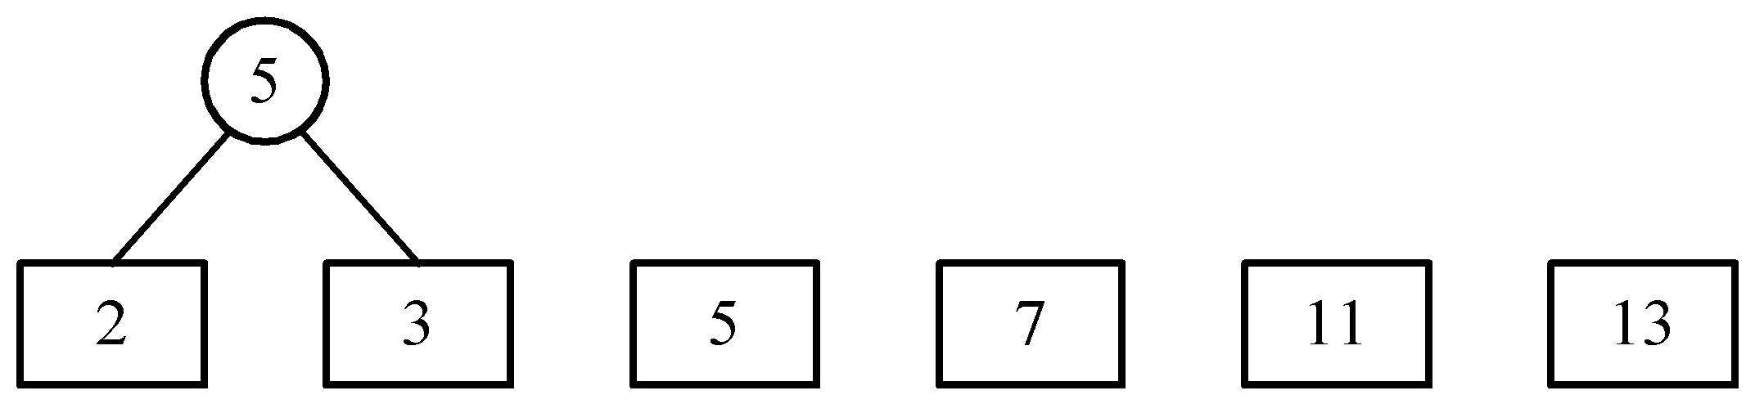
An example of 2-way merging
Example: 6 sorted lists with lengths 2, 3, 5, 7, 11 and 13.
3 -<number>

Slide 23
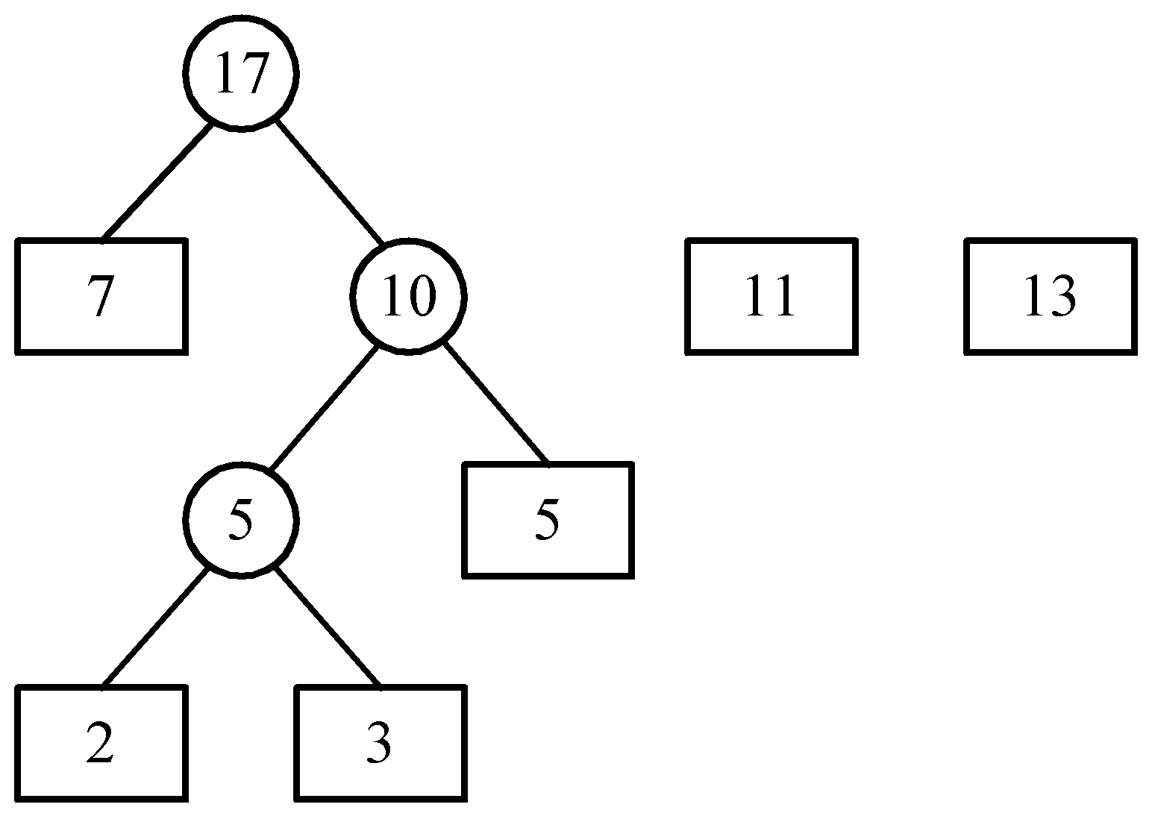
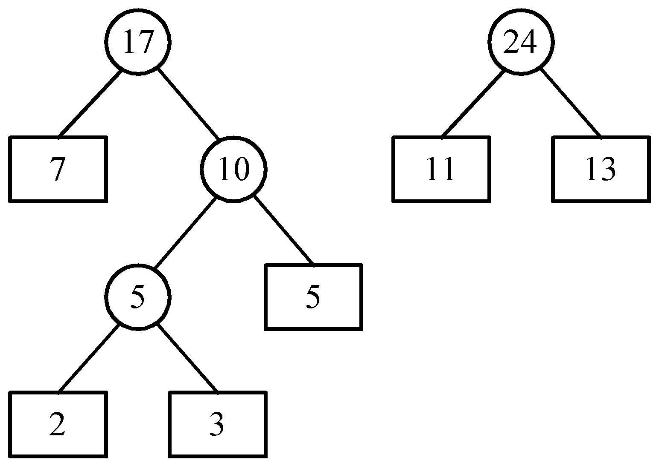
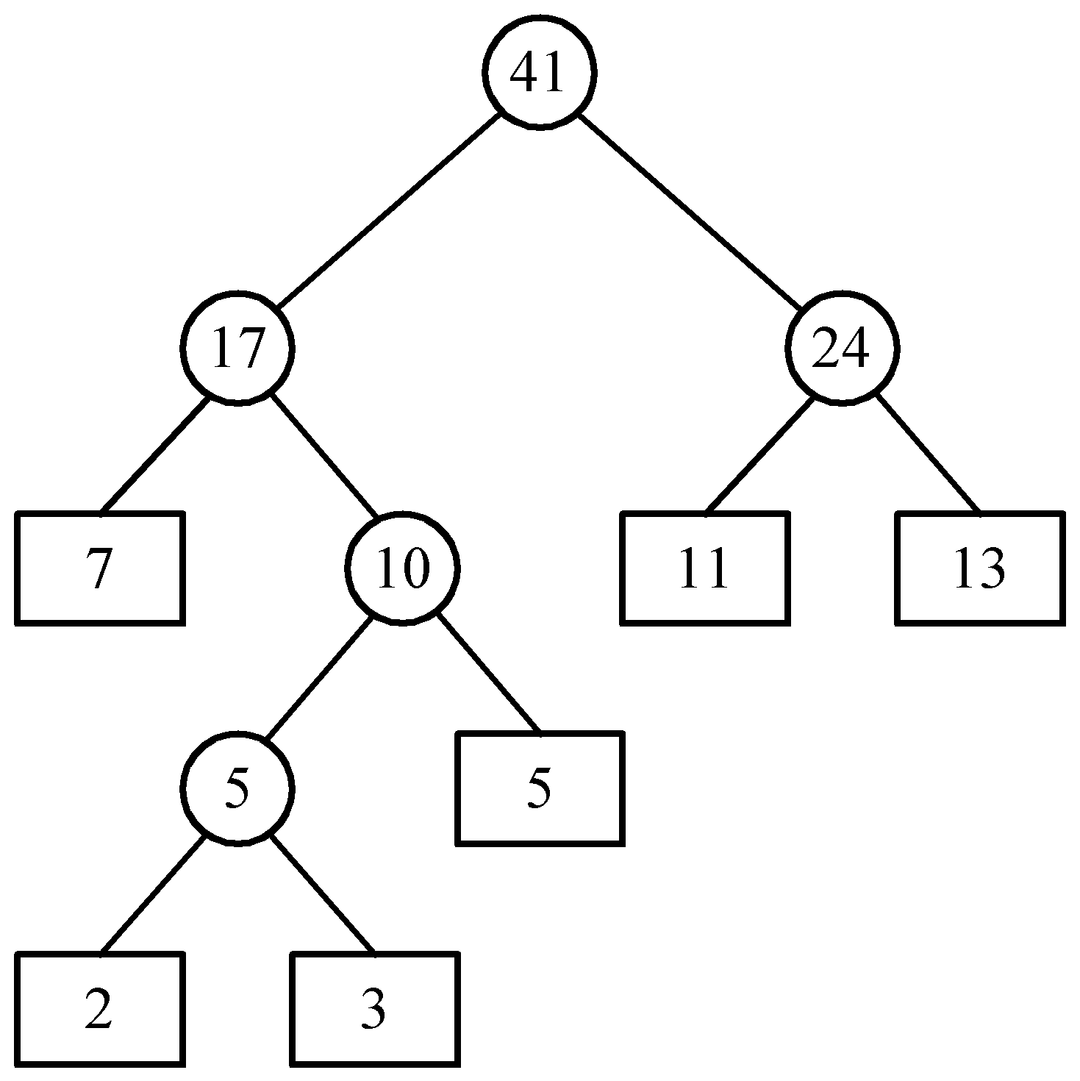
Time complexity of the 2-way merge algorithm is O(n log n).
3 -<number>

Slide 24
Huffman codes
In telecommunication, how do we represent a set of messages, each with an access frequency, by a sequence of 0’s and 1’s?
To minimize the transmission and decoding costs, we may use short strings to represent more frequently used messages.
This problem can by solved by using the 2-way merge algorithm.
3 -<number>

Slide 25
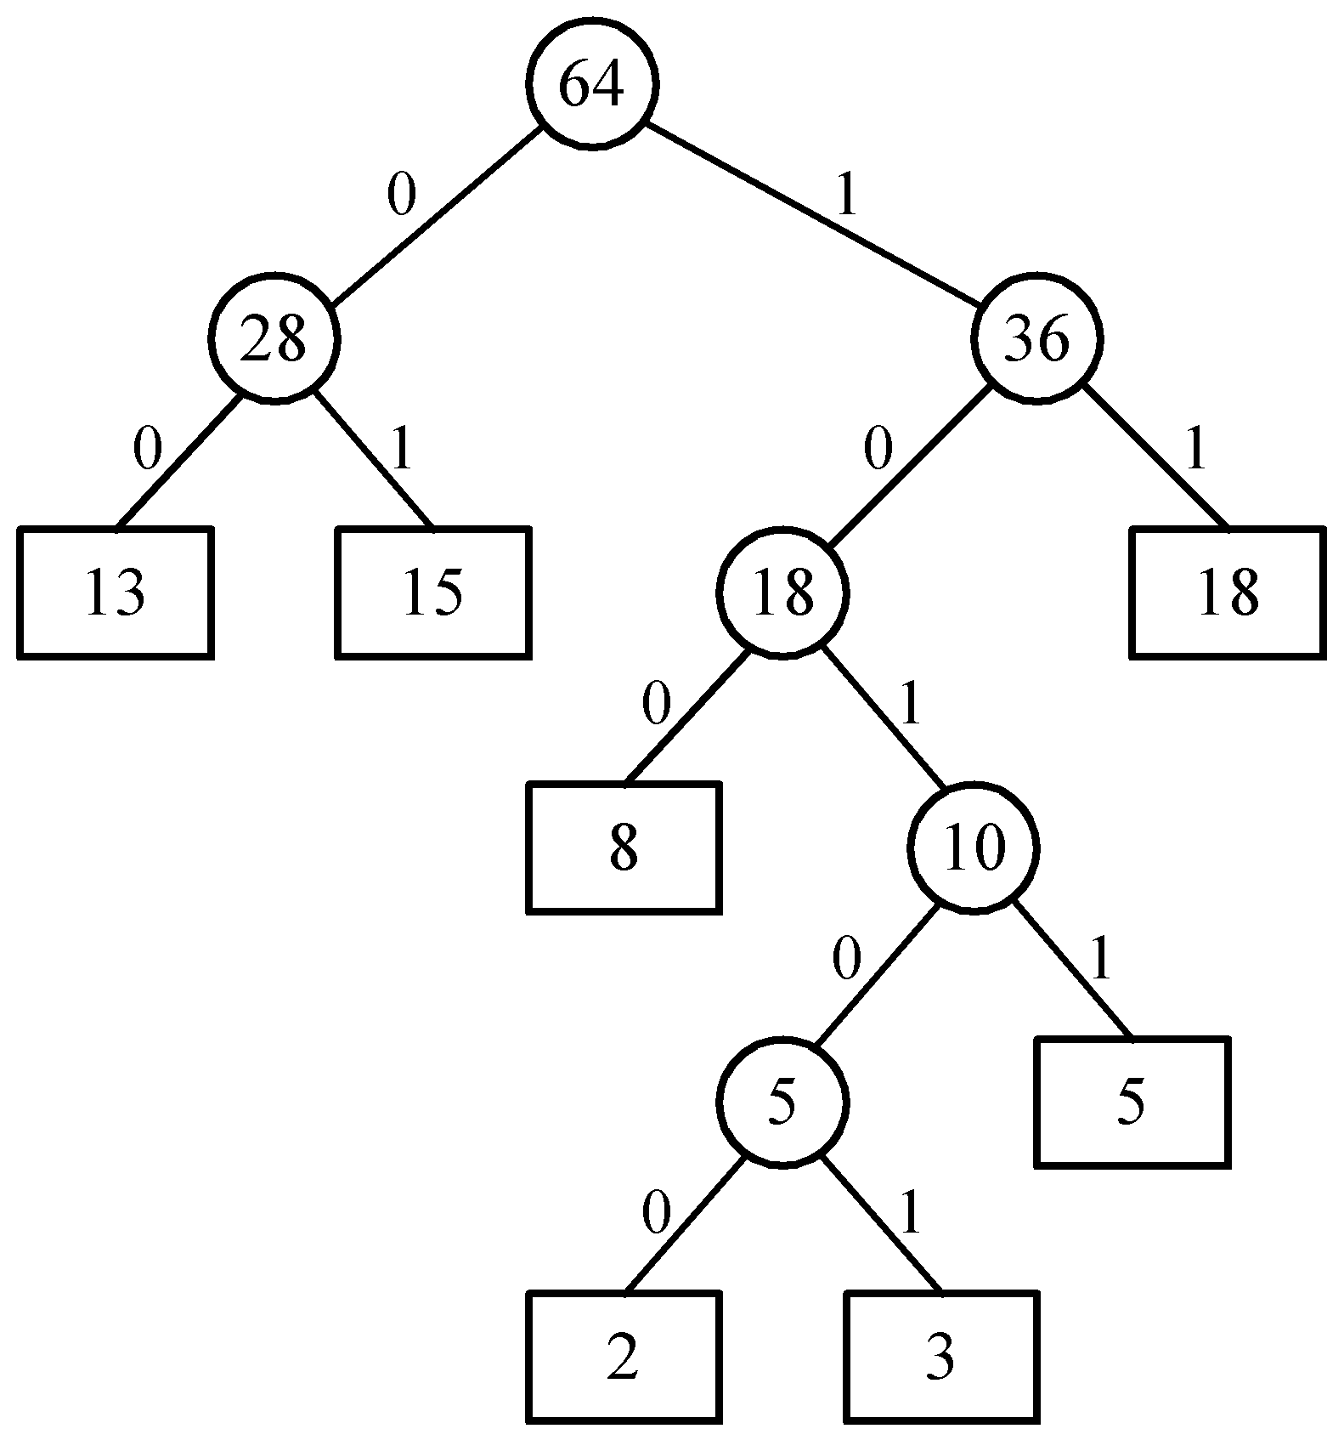
An example of Huffman algorithm
Symbols: A, B, C, D, E, F, G
freq. : 2, 3, 5, 8, 13, 15, 18
Huffman codes:
A: 10100 B: 10101 C: 1011
D: 100 E: 00 F: 01
G: 11
A Huffman code Tree
3 -<number>

Slide 26
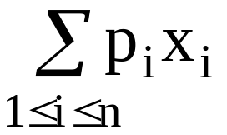
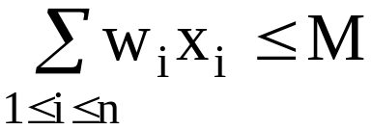
The knapsack Problem
n objects, each with a weight w_{i} > 0
a profit p_{i} > 0
capacity of knapsack: M
Maximize
Subject to
0 ≤ x_{i} ≤ 1, 1 ≤ i ≤ n
3 -<number>

Slide 27
The knapsack algorithm
The greedy algorithm:
Step 1: Sort p_{i}/w_{i} into nonincreasing order.
Step 2: Put the objects into the knapsack according
to the sorted sequence as far as possible.
e.g.
  n = 3, M = 20, (p₁, p₂, p₃) = (25, 24, 15)
  (w₁, w₂, w₃) = (18, 15, 10)
  Sol: p₁/w₁ = 25/18 = 1.32
  p₂/w₂ = 24/15 = 1.6
  p₃/w₃ = 15/10 = 1.5
  Optimal solution: x₁ = 0, x₂ = 1, x₃ = 1/2
3 -<number>

Slide 28
The knapsack problem is different from the 0/1 knapsack problem. In the 0/1 knapsack problem, x_{i} is either 0 or 1 while in the knapsack problem, 0 ≤ x_{i} ≤ 1.
3 -<number>

